Slide 1


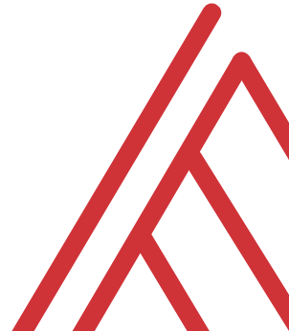
Advancing into Analytics: From Excel to R and Python

Slide 2
Chat me up…
What excites you about these topics? What scares you?
What has blocked you?

Slide 3


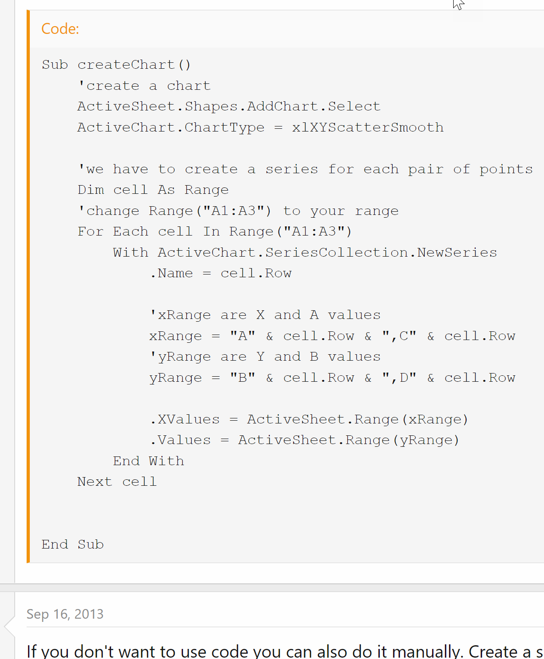
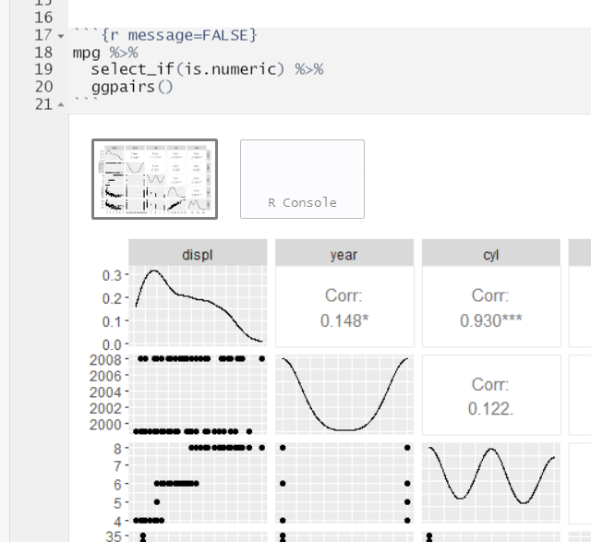
“I want to make a scatterplot for every pair of variables in my dataset”
https://www.mrexcel.com/board/threads/excel-2010-plot-lines-between-multiple-ordered-pairs.726760/
Notes:
This is a “cold open” example. Do you want to see more? I hope so!

Slide 4

Learning objectives
Situate Excel and R in the analytics stack 🍰
Introduce the R ecosystem 🏞
Have fun with data! 🎉
Possibly win a book? 📕
Notes:
And even if you don’t win I will show you how to read it for free.

Slide 5
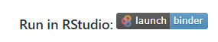
Follow along
Download resources: https://github.com/stringfestdata/rstudio-mar-2022
Code > Download ZIP
Run on the cloud:
Notes:
If you’d like to follow along with the presentation, all resources are available at this link.
I also wanted to give a shout-out to Alan Turing, born on this day in 1912.

Slide 6
Questions?

Slide 7
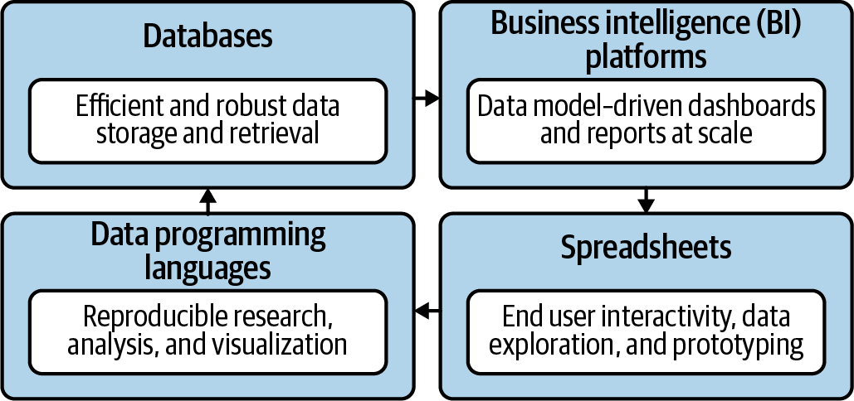
Become a full-stack analyst
Mount, George. Advancing into Analytics: From Excel to Python and R. O’Reilly Media, 2021
Notes:
Now this figure comes from my book and it’s a very broad conceptualization of the various slices of the stack. You know we hear engineers or web developers talk about being “full stack” all the time but it’s not so common an expression as it could be.

Slide 8
Where can R help?

Slide 9
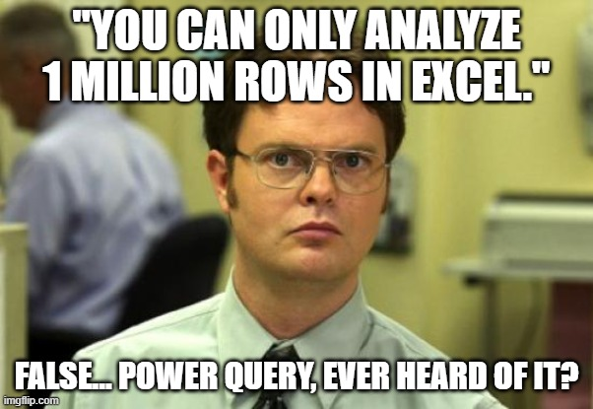
Where does R shine vs Excel/pq?
“Scalable” data visualizations 📈
Groupwise operations 👨‍👩‍👦‍👦
Window functions 🏠
Robust randomization 🧮
Notes:
And even if you don’t win I will show you how to read it for free.

Slide 10
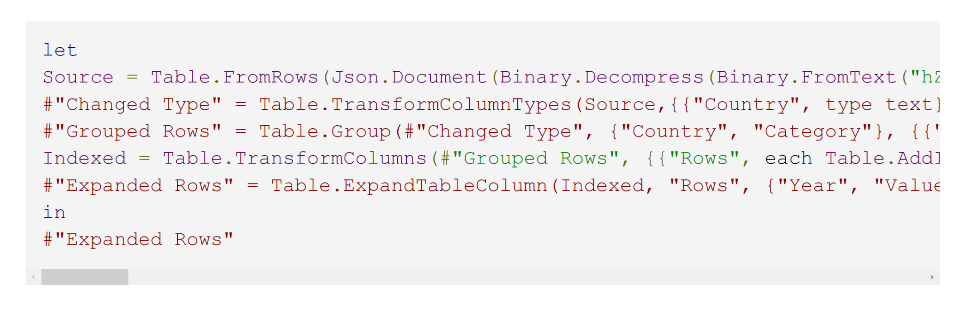
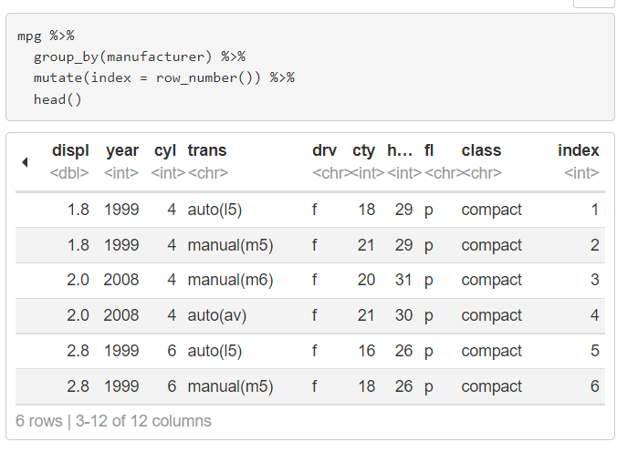
“I want to create an index column by group”
https://datacornering.com/how-to-create-group-index-with-power-query-or-r/
Notes:
This is a “cold open” example. Do you want to see more? I hope so!

Slide 11
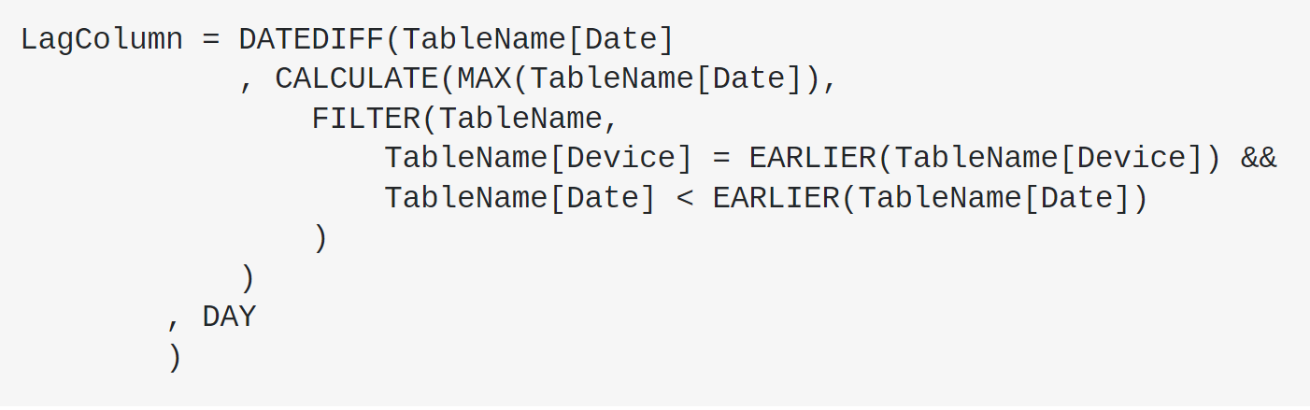
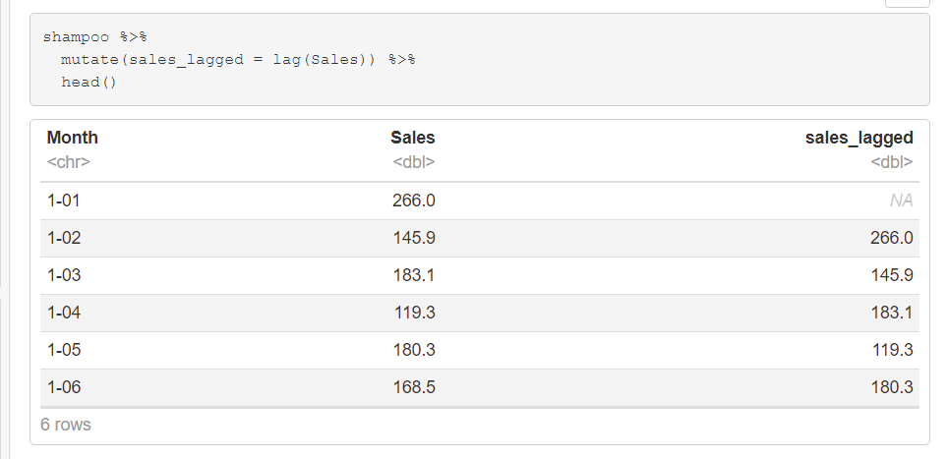
“I want to create a lagged variable”
https://stackoverflow.com/questions/37446950/powerbi-time-lag-calculation-in-dates-using-query-editor
Notes:
This is a “cold open” example. Do you want to see more? I hope so!

Slide 12
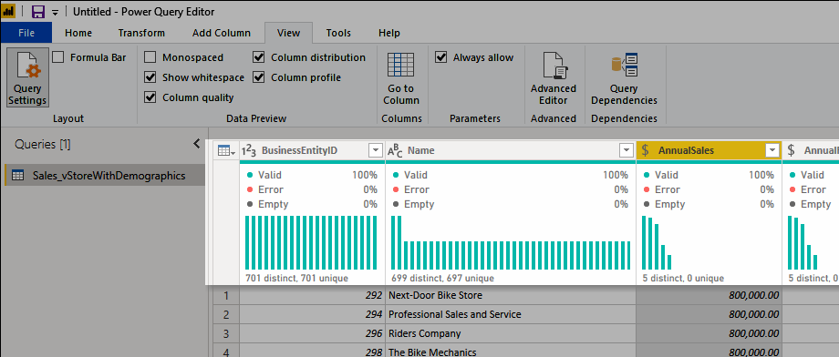
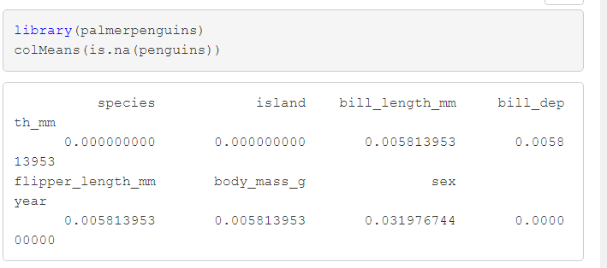
“I want to know what percent of values in each column are missing”
https://docs.microsoft.com/en-us/power-query/data-profiling-tools
Notes:
This is a “cold open” example. Do you want to see more? I hope so!

Slide 13
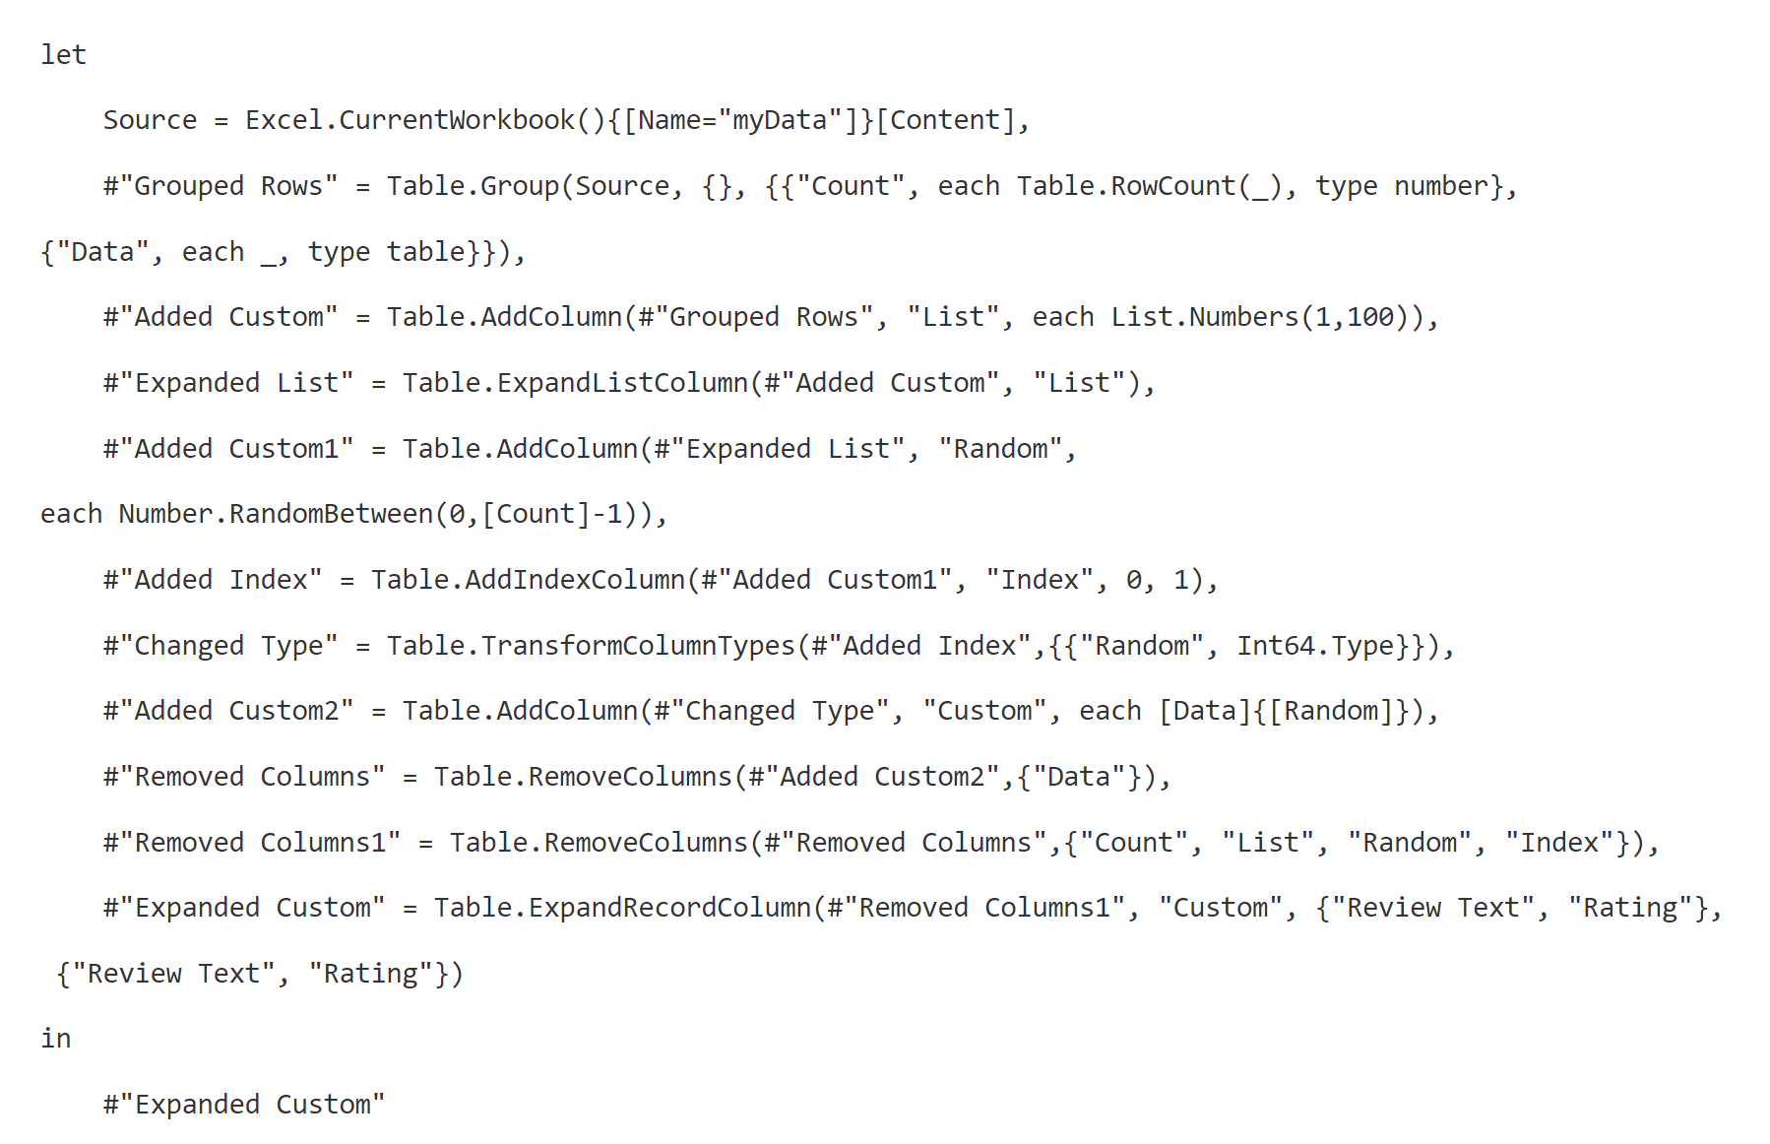
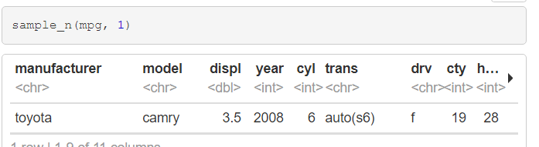
“I want to pick a row at random from my very large dataset”
https://chandoo.org/wp/power-query-random-sample/
Notes:
This is a “cold open” example. Do you want to see more? I hope so!

Slide 14
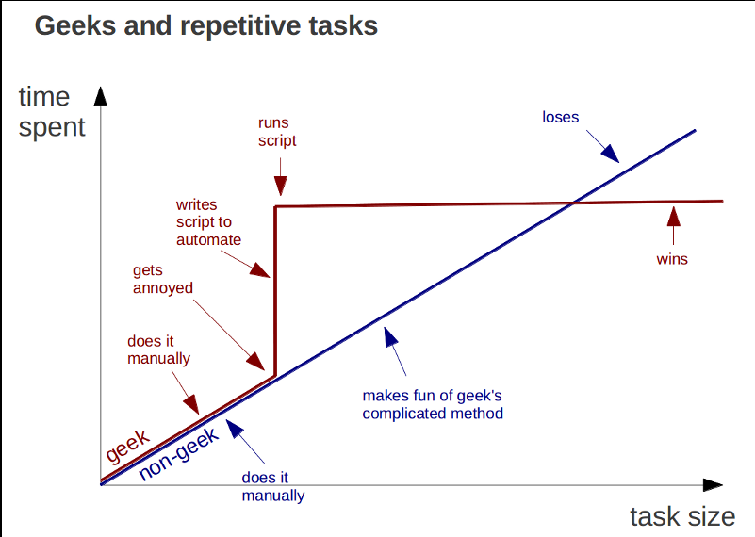
Learning R is a knowledge investment that pays off
https://marcgg.com/blog/2015/09/30/automate-repetitive-tasks/
Notes:
And even if you don’t win I will show you how to read it for free.

Slide 15
Questions?
Are you ready for a giveaway?

Slide 16
Are you ready for some databaseball?

Slide 17

Demo
Is there a relationship between MLB team payroll and game attendance? Wins?
R script: databaseball.rmd
Notes:
OK so now you will see R’s equivalent to some of those features you saw with Python. I think that for different reasons Python seems to be taking the lead on Excel automation, but R has some pretty robust features and in some ways are richer than Python’s.

Slide 18
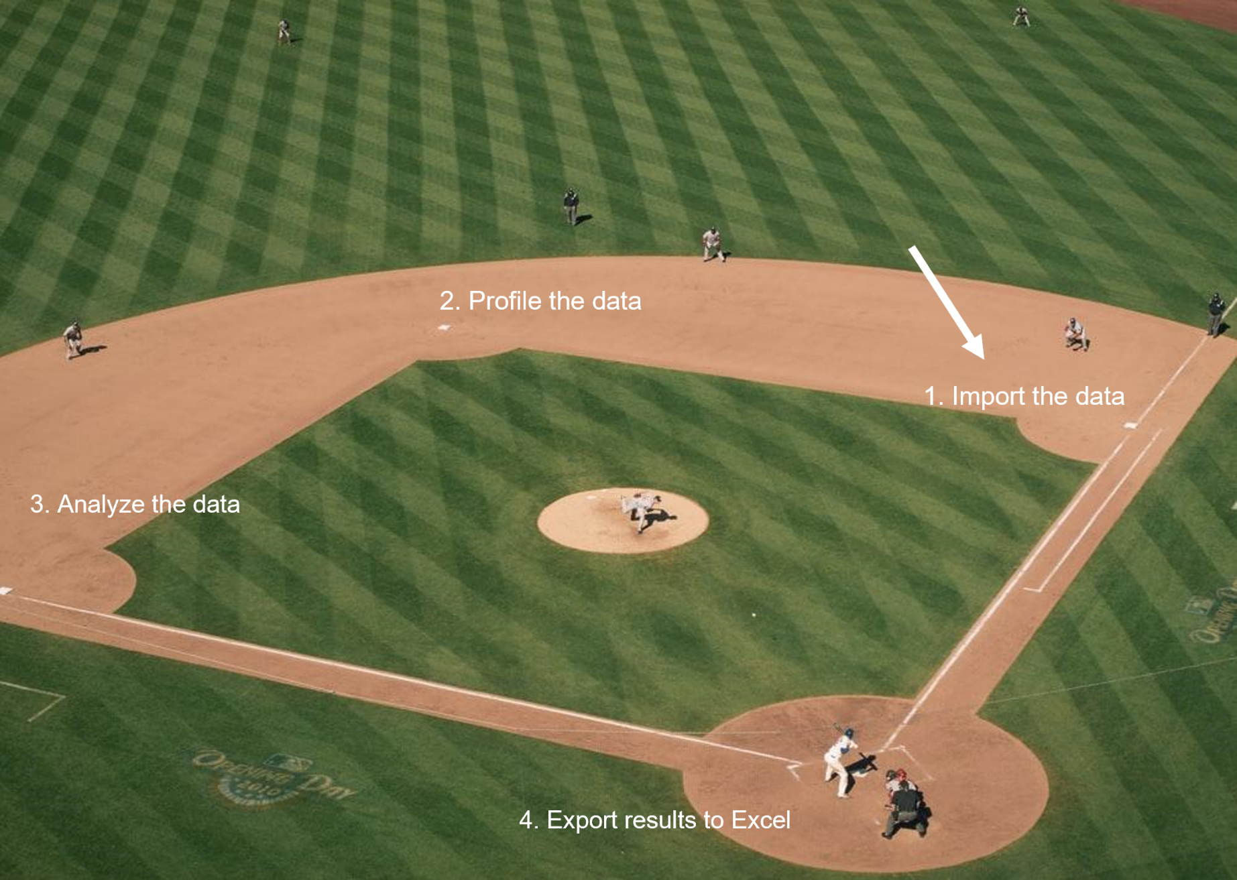
We’re on first…

Slide 19
Questions?
How about another giveaway?

Slide 20
Advancing into Analytics
Buy a copy or read for free: https://stringfestanalytics.com/book/
Notes:
And even if you don’t win I will show you how to read it for free.

Slide 21
THANK YOU
george@stringfestanalytics.com
linkedin.com/in/gjmount
stringfestanalytics.com/contact

